Slide 1
Literature Study this week;
Weekly Meeting (# 2)
TEA; PME; NTHU;
Good Afternoon Everyone
Microphone far-field array signal processing - Source amplitude estimation using Particle Filters;
Simulation in MATLAB;
Results; Plots;

Slide 2
A Tutorial on Particle Filters for Online Nonlinear/Non-Gaussian Bayesian Tracking
Sequential Monte Carlo methods based on point mass (or “particle”) representations of probability densities.
Can be applied to any state-space model.
The main advantages-
Takes care of the elements of non-linearity and non-Gaussianity,
Instantaneous processing of the data (prediction and update)-
No storage costs.
Rapid adaptation to changing signal characteristics.

Slide 3
Representation of dynamic systems
The state sequence is a Markov random process.
State equation: x_{k}=f_{x}(x_{k-1}, u_{k})
x_{k} : state vector at time instant k
f_{x} : state transition function
u_{k} : process noise with known distribution
Observation equation: z_{k}=f_{z}(x_{k}, v_{k})
z_{k} : observations at time instant k
f_{x} : observation function
v_{k} : observation noise with known distribution

Slide 4
The two models
System Model - Evolution of the state with time.
Measurement Model – Relates noisy measurements to the states.
Objective: To construct the posterior pdf

Slide 5
The two stages
Prediction –
Uses the system model to predict the state pdf forward from one measurement time to the next.
Generally translates, deforms and spreads the state pdf.
Update –
Uses latest measurement to modify the prediction pdf.
Achieved by Bayes’ Theorem.

Slide 6

Prediction
Defined by system model equation and known statistics of
u_{k-1}

Slide 7


Update
where the normalizing constant-
depends on the likelihood function which is defined by the measurement model equation and known statistics of
v_{k}

Slide 8
Optimal and Suboptimal Algorithms
Optimal:
Kalman Filter:
Assumes posterior density at each time step is Gaussian.
Grid Based Methods:
Works only for discrete state space and finite number of states.
Suboptimal:
Extended Kalman Filter.
Approximate Grid Based Methods.

Slide 9


PF-Sequential Importance Sampling
Algorithm:
Here is given by the equation:

Slide 10

Degeneracy Problem
After a few iterations, all but one particle will have negligible weight.
Implies waste of large computational effort which is devoted to updating particles whose contribution to
is almost zero.
Measure of Degeneracy:

Slide 11

Degeneracy Problem (contd.)
where is the true weight.
Severe degeneracy-
Solutions:
Good choice of Importance Density
Resampling

Slide 12
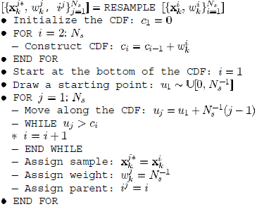
Resampling Algorithm

Slide 13

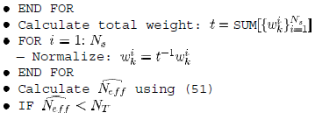

Generic Particle Filter- Algorithm

Slide 14
Sequential Importance Resampling (Recap)
SIR is a very commonly used particle filtering algorithm, which approximates the filtering distribution by a weighted set of P particles:
Steps:
For draw samples from the proposal distribution
For update the importance weights up to a normalizing constant:

Slide 15



SIR (contd.)
For compute the normalized importance weights:
Compute an estimate of the effective number of particles as
If the effective number of particles is less than a given threshold , then perform resampling (to avoid degeneracy):

Slide 16
SIR (contd.)
Draw P particles from the current particle set with probabilities proportional to their weights. Replace the current particle set with this new one.
For set

Slide 17
Other Particle filters:
Auxiliary SIR filter
Regularized PF’s
Likelihood PF’s

Slide 18
Conclusions
The EKF approximates the models used for the dynamics and measurement process in order to be able to approximate the probability density by a Gaussian.
Approximate grid-based filters approximate the continuous state space as a set of discrete regions.
This necessitates the predefinition of these regions and becomes prohibitively computationally expensive when dealing with high-dimensional state spaces.
Particle filtering approximates the density directly as a finite number of samples.
A number of different types of particle filter exist, and some can outperform others when used for particular applications.
However, when designing a particle filter for a particular application, it is the choice of importance density that is critical.

Slide 19
Authors of this paper
M. Sanjeev Arulampalam
Simon Maskell
Neil Gordon
Tim Clapp

Slide 20
Far-field array signal processing using 11 microphones:
Source amplitude estimation using Particle Filters;
Process Equation:
Measurement Equation:
+ v₂(m)

Slide 21
Matlab Simulation Results
Still some things are incomplete…

Slide 22
Thank you for listening

